Slide 1
Zillow Home Investment Recommendation
Case Study: Zillow Home Price
July 22, 2021

Slide 2
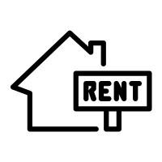


Project Summary: Data, Process and Assumptions
Through 10 years of holding onto properties, we want to make the most profit with low risk for our client with $500k initial fund
Process
Assumptions
Time
FY2021
FY2021 – FY2030
FY2030
Current date is 02/01/2021
FY2021 is defined as from 02/01/2021 to 01/31/2022
Home price and rent of each location will grow with respective historical CAGR
Rent will be updated price at the beginning of each year and collected in the end of each year
There are homes with exact the typical price and rent to be invested in
The rest of the initial find will not be considered to generate any profit or loss
02/01/2021
02/01/2021 – 01/31/2031
01/31/2031
Buy properties with up to $500k cash
Rent out and collect 9 years of rent from 2nd year on at the end of each year
Income from selling the properties
Price
Data
Investment
8,925 rows of typical home price and monthly rent in the end of each month from 01/31/2014 to 01/31/2021 of 105 *MSAs across 40 states in the U.S.
The average latest price is $310,551 with past 7 years’ CAGR as 5.57%; the average latest monthly rent is $1519 with CAGR 3.89%
*Metropolitan statistical areas (MSA) are delineated as having at least one urbanized area with a minimum population of 50,000.
Notes:
Compound annual growth rate

Slide 3

Optimal Solution
To make the most profit with low risk out of investment in the U.S. real estate market, we recommend the client to invest in 2 properties
Option | Location | Price CAGR FY2014-FY2020 | Rent CAGR FY2014-FY2020 | Purchase Price FY 2021 start | *Monthly Rent FY2021/ FY2030 | *Commission FY 2021 end | *Sell Price FY2030 end | NPV of Investment
Option 1 | Melbourne, FL | 8.24% | 6.52% | $250,641 | $1543/ $2725 | $18,516 | $553,347 | $393,955
 | Grand Rapid, MI | 7.94% | 5.93% | $247,504 | $1296/ $2177 | $15,552 | $531,477 | $325,748
 | Total | 8.09% | 6.25% | $498,145 | $2839/ $4902 | $15,552 | $1,084,824 | $719,703
Option 2 | Boise City, ID | 10.59% | 6.78% | $395,486 | $1412/ $1355 | $16,944 | $1,081,733 | $626,587
Summary
The optimal solution is to invest into a typical mid-level home in Melbourne, FL, and another in Grand Rapid, MI. The expected NPV of the investment is $720k, resulting in a 144% ROI.
A back-up plan ,with the advantage of convenience, is to invest in a typical mid-level home in Boise City, ID. NPV of this investment is $627k, resulting in a 125% ROI.
Notes:
NPV (net present value)=TVECF−TVIC
where:TVECF=Today’s value of the expected cash flowsTVIC=Today’s value of invested cash​

Slide 4
Methodology: Build the DCF model and optimize towards best NPV
Step 1: DCF model to get the NPV of investing in each home and PV of commission (Excel)
Calculate the PV of purchase, rent (from FY2022 on), and sale of each property, save sum as PV_1
Calculate the PV of rent in FY2021 of each property, saved as PV_2*
02/28/2014
02/01/2021
01/31/2022
02/01/2022 – 01/31/2031
01/31/2031
Calculate price CAGR
Buy home(s)
Predict rent income and discount
Predict rent income and discount
Predict home price and discount
Calculate rent CAGR
Step 2: Optimize towards highest NPV (Python)
Scenario 1 - Purchase 1 property: to select the property with NPV = max(PV_1)
Scenario 2 - Purchase multiple properties: to select the combination of properties with NPV = max(sum(PV_1+PV_2)-min(PV_2)) from different states
Example:
 | PV_1 | PV_2 | Target NPV
Melbourne, FL | $375,903 | $18,052 | $719,703
Grand Rapid, MI | $325,748 | $15,162
Both Scenarios are run under the condition of home-buying cost <= $500k

Slide 5
Recommendations Deep Dive: Why The Best is the best?
Solution | Location | Home-buying cost | NPV | Pros | Cons
The Best Choice | Melbourne, FL Grand Rapid, MI | $498,145 | $719,703 | High NPV Low risk from investing in 2 states Low risk from rent income accounting for 30% of the total income* | Inconvenience of maintaining properties across the states
The Easiest | Boise City, ID | $395,486 | $626,587 | Convenience from only maintaining one property Freedom to leverage the rest $100k cash | Low NPV High risk from only investing in 1 property High risk from rent income only accounting for 18% of the total income
Upper Limit | Daytona Beach, FL Port St. Lucie, FL | $499,453 | $745,178 | Highest NPV Low risk from rent income accounting for 33% of the total income | High risk from only investing in 1 state Inconvenience of maintaining properties in different cities
Spread The Eggs | Lakeland, FL Memphis, TN Youngstown, OH | $497,926 | $677,990 | Low risk from investing in 3 states Low risk from rent income accounting for 36% of the total income | Inconvenience of maintenance properties across the states Relatively low NPV
Takeaways
Different solutions might be applied according to the customer’s preference of return(NPV), risk, convenience, and freedom
Investing in more than 3 properties** can only gain ~$500k NPV at most which is too low to be an option
*The national average rent income proportion out of (rent income + home sale income) in the DCF model is 28.7%. High rent proportion is safer because rent is collected earlier than sales income
** Cheapest price of home is $112k, so we can at most buy 4 properties
Notes:
Reason of Florida’s real estate market’s booming: population growth, quality of life

Slide 6
Future Development
Common ad-hoc questions
Q: What if the budget can be higher than $500k?
A: We can put every cents in the home investment and achieve the best ROI. $656k in Boise City and Port St. Lucie can theoretically result in $1M+ NPV and 158% ROI
Q: What if the CAGR of Melbourne and Grand Rapids in the next 10 years are not as good as they were in the past 7 years?
A: Assuming they will only have the national average CAGR, the NPV of the investment will be $503k, which provides a conservative estimation of the best solution
……
Optimization Engine Design
Scrape from Zillow
Price Inputs
Rent Inputs
Optimization
DCF Details
Report
User Input in UI
Fund Inputs
Optimization Data Output
Visualization
Preference Inputs

Slide 7
Thank you!
Any questions?

Slide 8
Appendix
DCF Formula and Example
Python Code for Optimization
Top 10 properties in terms of ROI
Example of Visualization Output
Florida real estate market remarks

Slide 9
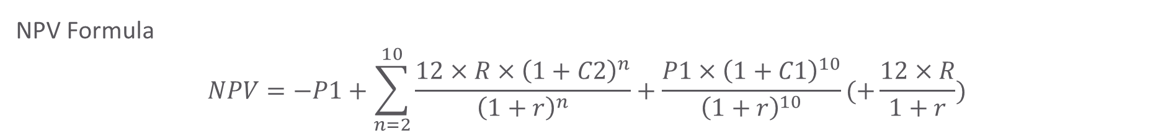
Appendix
DCF Model and Example
 | Price CAGR FY2014-FY2020 | Rent CAGR FY2014-FY2020 | Purchase Price FY 2021 | *Monthly Rent FY2021 | *Commission FY 2021 end | *Sell Price FY2030 end | NPV
Property | C1 | C2 | P1 | R | CO=12*R | P2=P1*(1+C1)^10 | Formula as below
Grand Rapid, MI (Example) | 7.94% | 5.93% | $247,504 | $1296 | $15,552 | $531,477 | $325,748
NPV Formula
$$NPV=−P1+\sum_{n=2}^{10}{\frac{12×R×{\left(1+C2\right)}^{n}}{{\left(1+r\right)}^{n}}}+\frac{P1×{\left(1+C1\right)}^{10}}{{\left(1+r\right)}^{10}}(+\frac{12×R}{1+r})$$
NPV_1
NPV_2
only exists if it’s a property invested but not used by the analyst
If investing in multiple properties, only the first-year rent of one of them is not income;
The 10-year mortgage APR 2.57% is used as the IRR in the discounted cash flow

Slide 10
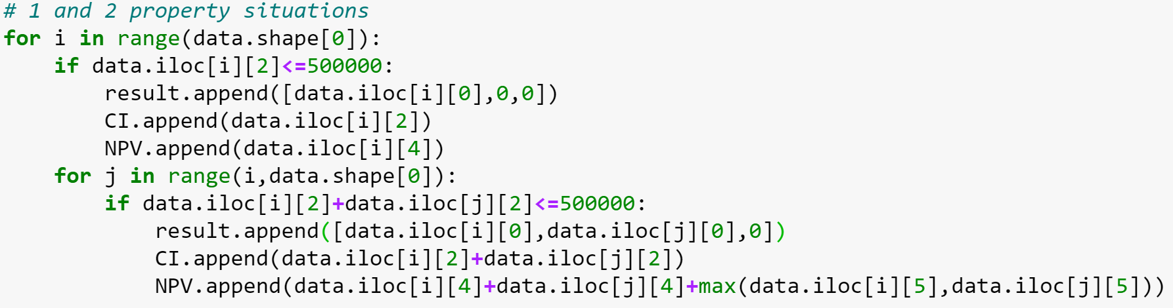
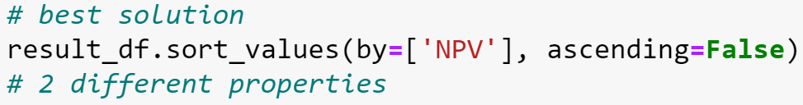
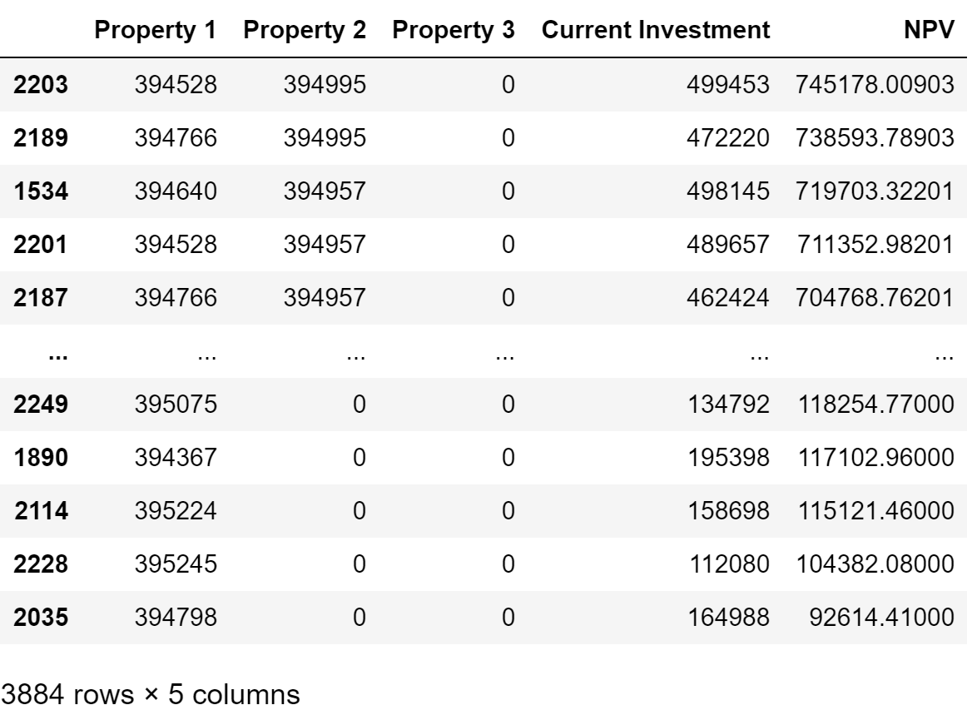
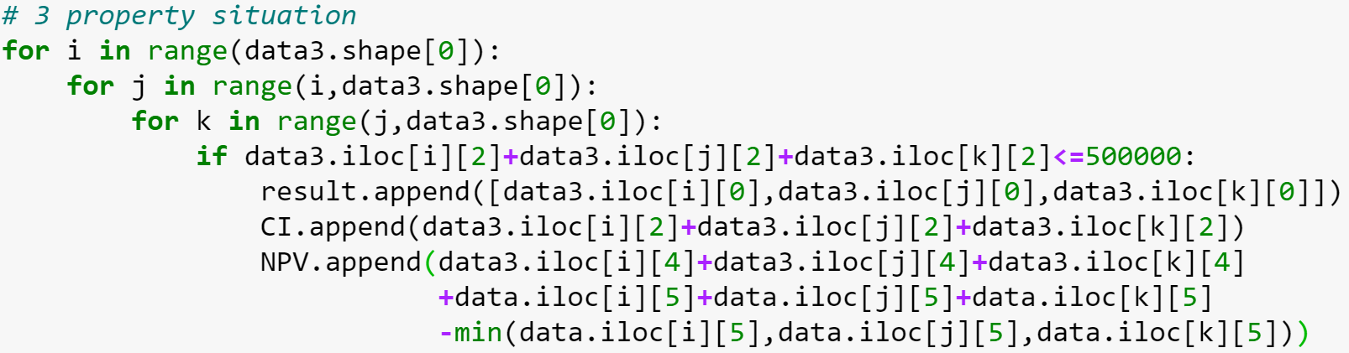
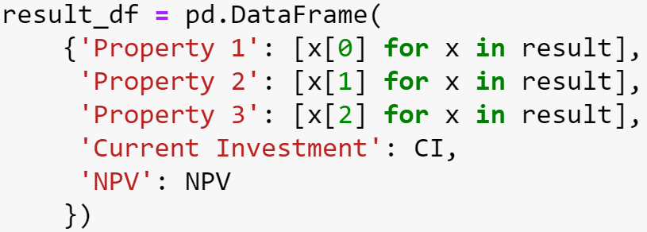
Appendix
Python Code for Optimization

Slide 11
Appendix
Top 10 properties in terms of ROI
Property Name | City Size Rank | Cost | NPV | ROI
Boise City, ID | 85 | $ 395,486 | $ 626,587 | 158%
Port St. Lucie, FL | 119 | $ 260,437 | $ 406,546 | 156%
Melbourne, FL | 97 | $ 250,641 | $ 375,903 | 150%
Lakeland, FL | 88 | $ 211,783 | $ 310,814 | 147%
Spokane, WA | 99 | $ 327,213 | $ 475,547 | 145%
Tampa, FL | 19 | $ 257,499 | $ 367,504 | 143%
Daytona Beach, FL | 90 | $ 239,016 | $ 317,398 | 133%
Grand Rapids, MI | 52 | $ 247,504 | $ 325,748 | 132%
Memphis, TN | 41 | $ 174,063 | $ 225,263 | 129%
Dallas-Fort Worth, TX | 4 | $ 273,348 | $ 352,155 | 129%
The tier-1 cities (high size rank) like New York or Los Angeles are not among the best investment targets even not considering the $500k limit of initial fund. With current home price and rent already quite high, there is limited space for them to keep growing in the next decade compared to the mid/low-tier cities.

Slide 12
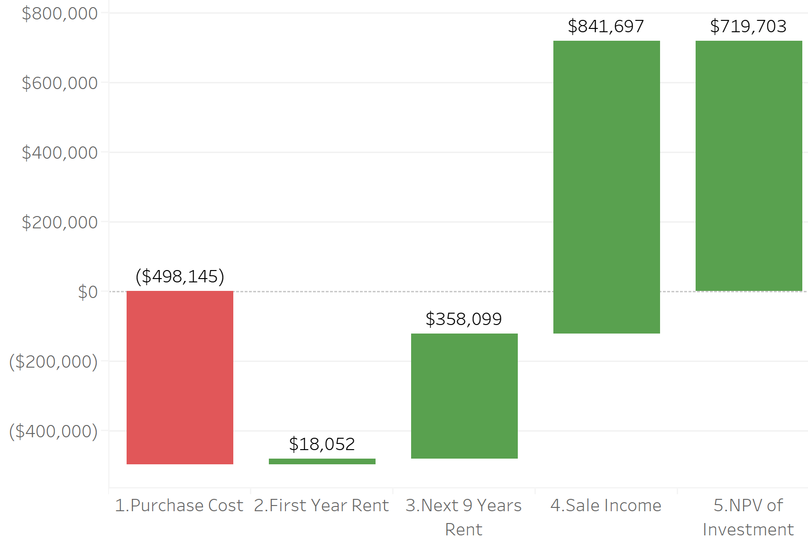
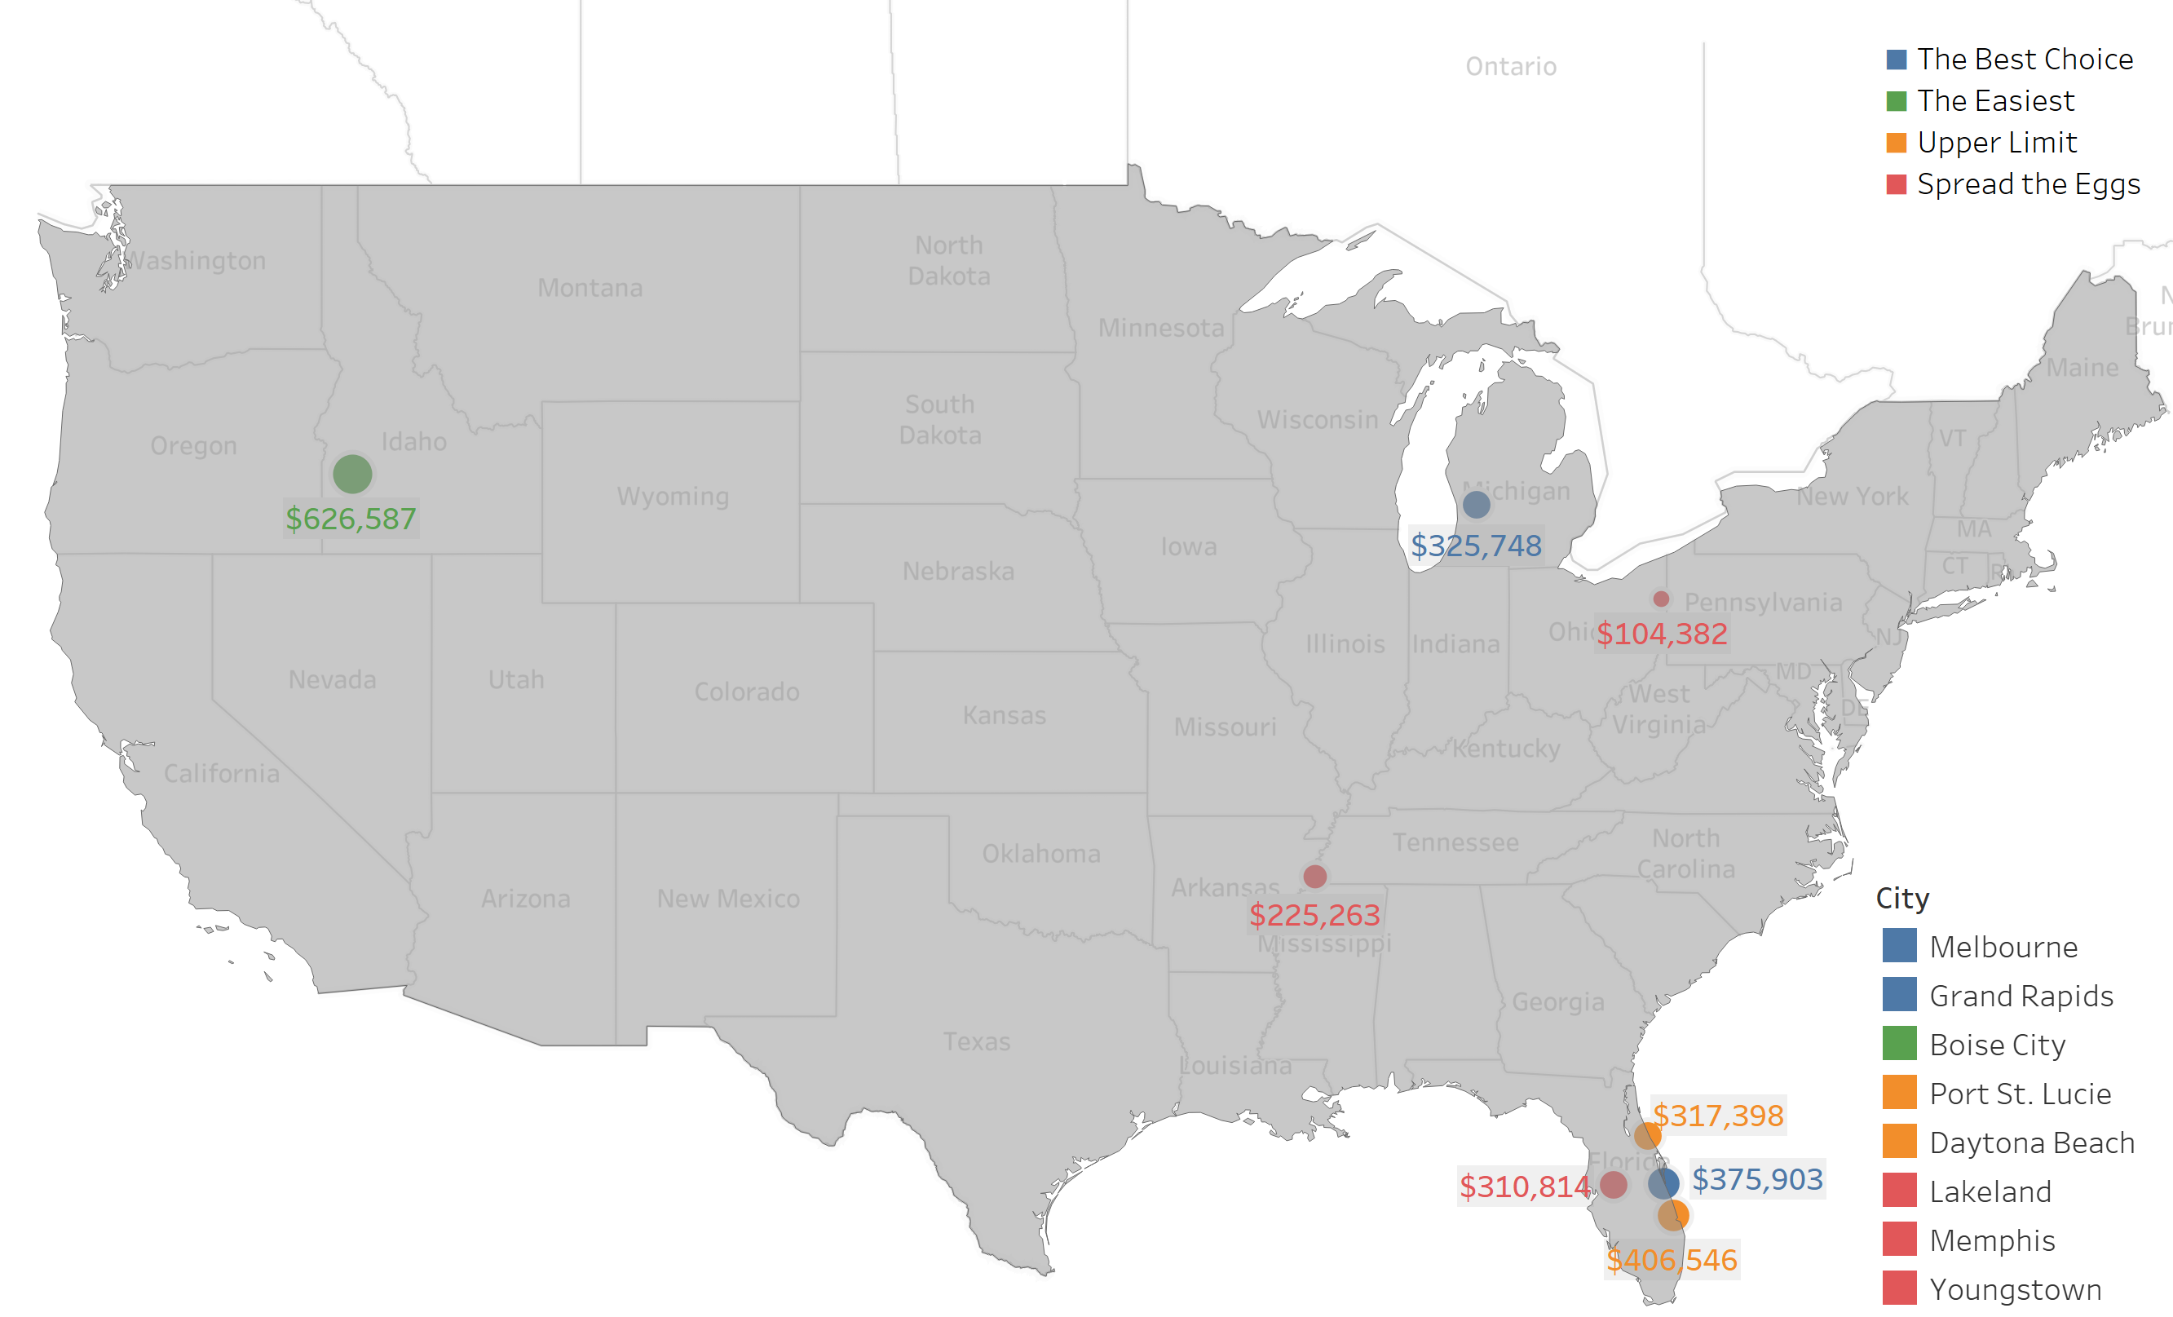
Appendix
Example of Visualization Output
Profit & loss of the best solution
Geographic selection of the recommendations

Slide 13
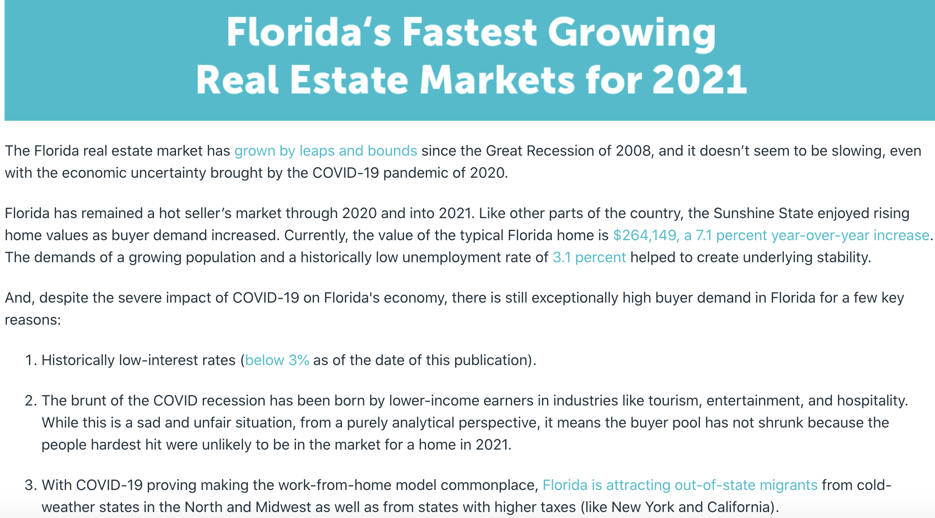
Appendix
Florida real estate market remarks
Half of the properties involved come from Florida. Compared to the national average, FL has an advantage for real estate investment for the low current price, high CAGR for price and rent growth, and high rent-to-price ratio
Data source: an estate agent training website: https://www.aceableagent.com/blog/floridas-fastest-growing-real-estate-markets-2021/
real estate investment website: https://learn.roofstock.com/blog/florida-real-estate-market

